Slide 1
Uygulama

Slide 2
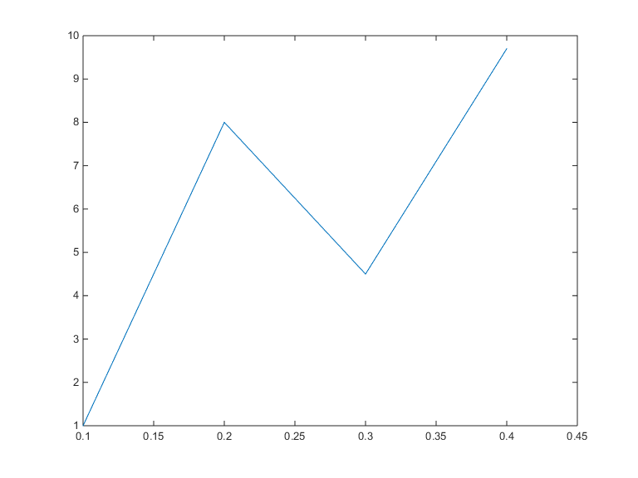
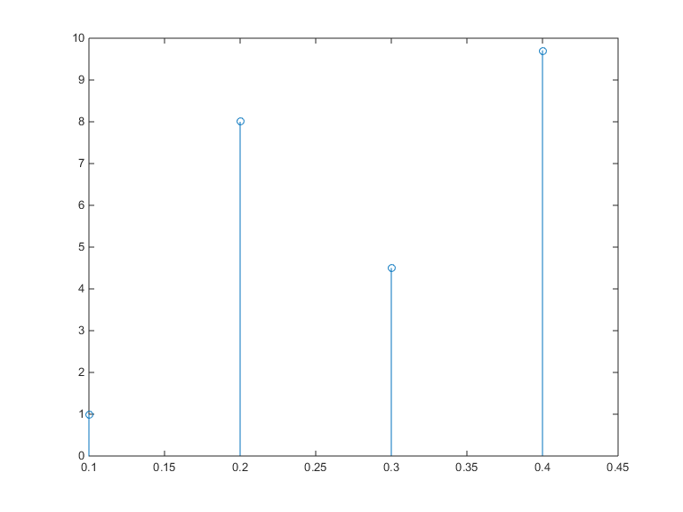
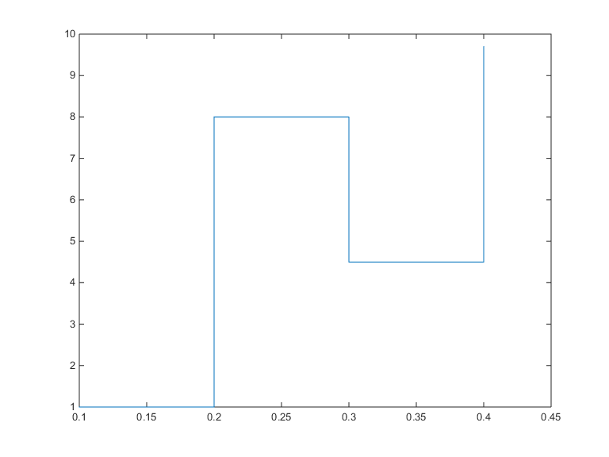
clear all
t = [0.1 0.2 0.3 0.4];
x = [1.0 8.0 4.5 9.7];
plot(t,x),
figure,stem(t,x),
figure, stairs(t,x)

Slide 3
fs=1000;
ts=0:1/fs:2;
f=250+240*sin(2*pi*ts);
x=0.1*sin(2*pi*f.*ts);
strips(x,0.25,fs)
sound(x,fs)
pause(1);
soundsc(x,fs)

Slide 4
f = inline('exp(-t).*cos(2*pi*t)','t')
t = 0;
f(t)
f(t);
t = (-2:2);
plot(t,f(t));
xlabel('t'); ylabel('f(t)'); grid;
t = (-2:0.01:2);
figure, plot (t,f(t)); xlabel('t'); ylabel('f(t)'); grid;

Slide 5

p = inline('(t>=0) & (t<1)','t');
t = (-1:0.01:2); plot(t,p(t));
xlabel('t'); ylabel('p(t) = u(t)-u(t-1)');
axis ([-1 2 -.1 1.1]);
u = inline('(t>=0)','t')
t = (-2:2);
plot (t,u(t)); xlabel('t'); ylabel('u(t)');
t = (-2:0.01:2);
figure, plot (t,u(t));
xlabel('t'); ylabel('u(t)');
axis ([-2 2 -0.1 1.1]);

Slide 6
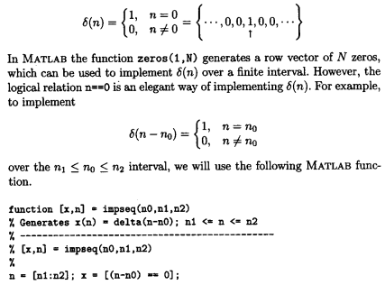
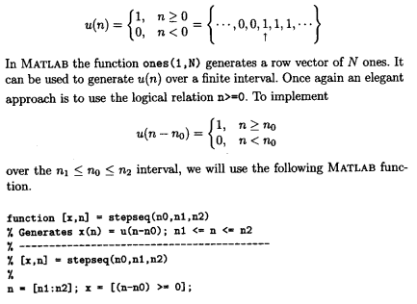
Birim darbe ve birim basamak işareti üretmek için;

Slide 7
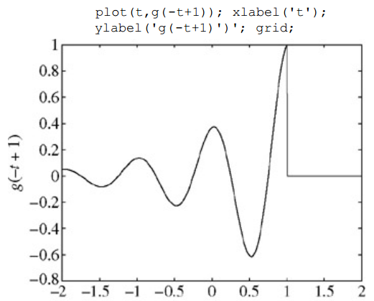
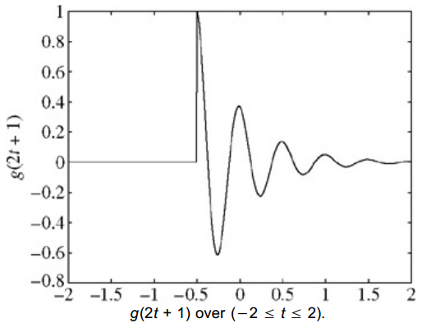

Slide 8
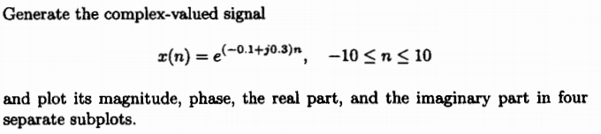
n=-10:1:10; alpha= -0.1+0.3*j;
x=exp(alpha*n);
subplot(221);stem(n,real(x));title('real part');xlabel('n')
subplot(222);stem(n,imag(x));title('imaginary part');xlabel('n')
subplot(223);stem(n,abs(x));title('magnitude part');xlabel('n')
subplot(224);stem(n,(180/pi)*angle(x));title('phase part');xlabel('n')

Slide 9
clc,clear all,close all
t = linspace(0, 8, 401); %Define a vector of times from 0 to 8 s with 401 points
x = t.*exp(-t).*cos(2*pi*4*t); %Define a vector of x values
plot(t,x); %Plot x vs t
xlabel('Time (s)'); %Label time axis
ylabel('Amplitude'); %Label amplitude axis

Slide 10
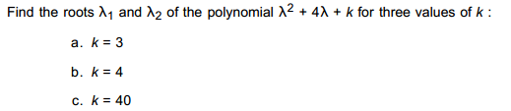


Sıfır Giriş Cevabı
y_0 = dsolve('D2y + 4*Dy + 3*y = 0','y(0) = 3','Dy(0) = -7','t');
disp(['(a) k = 3; y_0 = ',char(y_0)])

Slide 11
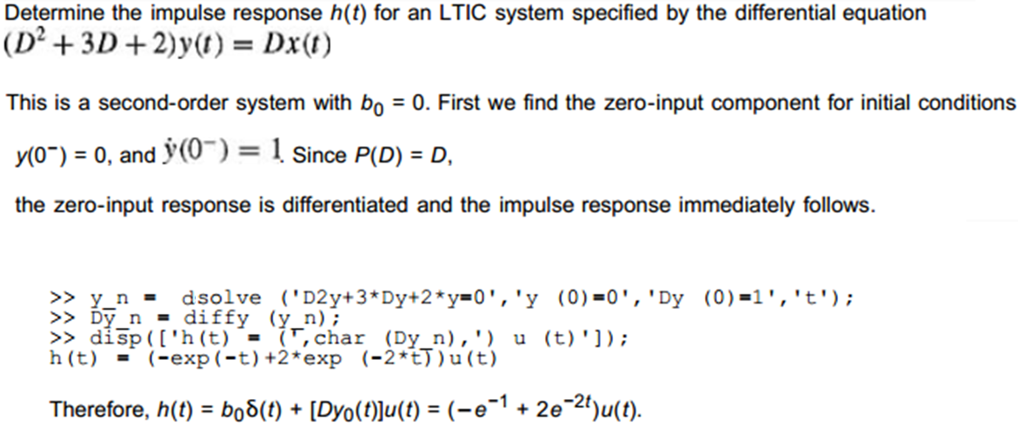

Slide 12
% Loading of test signal train
clear all
load train
whos
% Listening to/plotting train Signal
sound(y,Fs)
t=0:1/Fs:(length(y)-1)/Fs;
figure; plot(t,y'); grid
ylabel('y[n]'); xlabel('n')
% Using stem to plot 200 samples of train
figure
n=100:299;
stem(n,y(100:299)); xlabel('n');ylabel('y[n]')
title('Segment of train signal')
axis([100 299 -0.5 0.5] )

Slide 13
clear all
load clown
colormap ('gray')
imagesc (X)

Slide 14
% Creating a WAV file from scratch and reading it back
clear all
Fs=5000; % sampling rate
t=0:1/Fs: 5; % time parameter
y=0.1*cos(2*pi*2000*t)-0.8*cos(2*pi*2000*t.^2); % sinusoid and chirp
%% writing chirp.wav file
wavwrite(y, Fs,'chirp.wav')
%% reading chirp.wav back into MATLAB as y1 and listening to it
[y1, Fs, nbits, readinfo] = wavread('chirp.wav');
sound(y1, Fs) % sound generated
figure
plot(t(1:1000), y1(1:1000))

Slide 15
% Derivative and difference example
clf; clear all
% SYMBOLIC
syms t y z % define the symbolic variables
y=cos(t^2) % chirp, no . before ˆ , t is no vector
z=diff(y) % derivative
figure,subplot(211)
ezplot(y,[0,2*pi]);grid % plotting symbolic y between 0 and 2*pi
hold on
subplot(212)
ezplot(z,[0,2*pi]); grid
hold on

Slide 16
% NUMERIC
Ts=0.1; % sampling period
t1=0:Ts:2*pi; % sampled time
y1=cos(t1.^2); % sampled signal -- different from y above
z1=diff(y1)./diff(t1); % difference -- approximate derivative
figure,subplot(211)
stem(t1,y1,'k');axis([0 2*pi 1.1*min(y1) 1.1*max(y1)])
subplot(212)
stem(t1(1:length(y1)-1),z1,'k');axis([0 2*pi 1.1*min(z1) 1.1*max(z1)])
legend('Derivative (blue)','Difference (black)')
hold off

Slide 17
clear all; clf
syms y t x z
% input a unit-step signal
y=dsolve('D2y+5*Dy+6*y=heaviside(t)','y(0)=0','Dy(0)=0','t');
x=diff(y); % impulse response
z=int(y); % ramp response
figure
subplot(311)
ezplot(y,[0,5]); title('Unit-step response')
subplot(312)
ezplot(x,[0,5]); title('Impulse response')
subplot(313)
ezplot(z,[0,5]); title('Ramp response')

